Slide 1
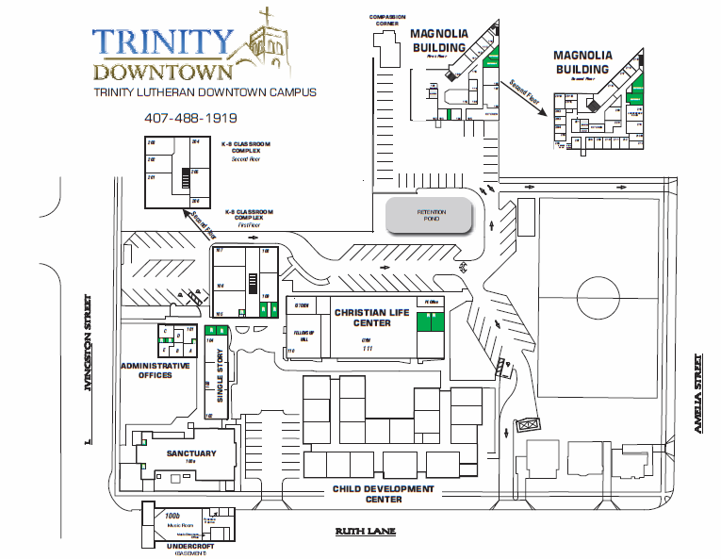
Motion: Name the new building housing the Child Development Center and the upstairs opportunity space, the “New Century Center”

Slide 2
Motion Continues: and to utilize space in the entrance area for a dedication to the vision and perseverance of Wren Aber a visionary who lead Trinity’s Campus Development Task Force into this new Century. The first fruits of this labor are the new building where the memorial will be placed. LC will select a committee to formalize existing discussions into a specific recommendation

Slide 3
TRINITY’S VISION (Matching The Campus To The Mission: $70m)
Trinity Century II:
Proclaim the Gospel of Jesus Christ through ministries which strengthen and equip people for Christian witness and service in downtown, Metropolitan Orlando and the world.
PHASE I: Sanctuary, Green Space, Office & CDC
PHASE II: Elementary School
PHASE III: Middle School
PHASE IV: Trinity Center
PHASE V: Auditorium & Gymnasium

Slide 4
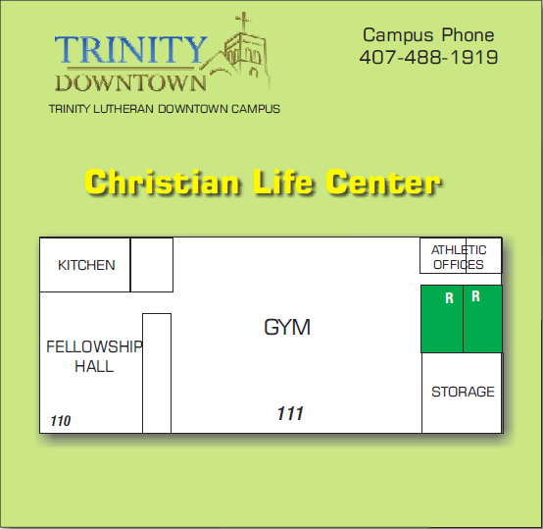
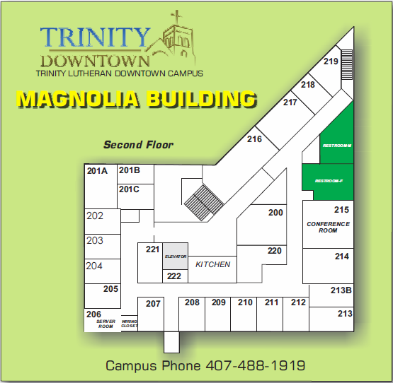
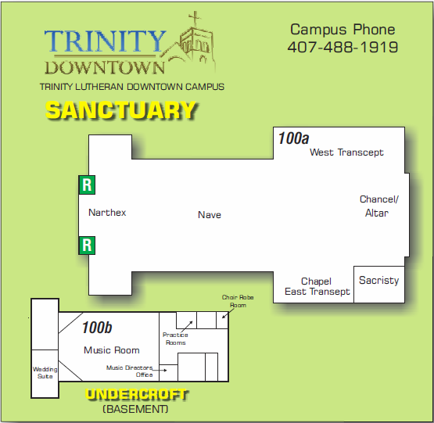
DISCUSSION POINTS
Existing Buildings
Christian Life Center
Magnolia Building
Sanctuary and Undercroft

Slide 5
Leadership would like consideration of names for other existing buildings ( Campus Orientation, Maps)
School Building
Two Story
One Story
Admin Office Building
Administration
Ruth and Amelia Houses
Yellow
White
Red

Slide 6
Suggested Names for Discussion
School Buildings
Two Story – “Heritage Hall”
One Story – “Loggia”
Admin Office Building
Administration – “Livingston Administration Building”
Ruth and Amelia Houses
Yellow – “Sycamore Corner”
White – “Mighty Oak Manner”
Red – “Cypress Cottage”

