Slide 1
Trinity Century II:
Matching The Campus To The Mission
Good servants invest their master’s
money wisely.
(The parable of the gold coins) LUKE 19:11

Slide 2
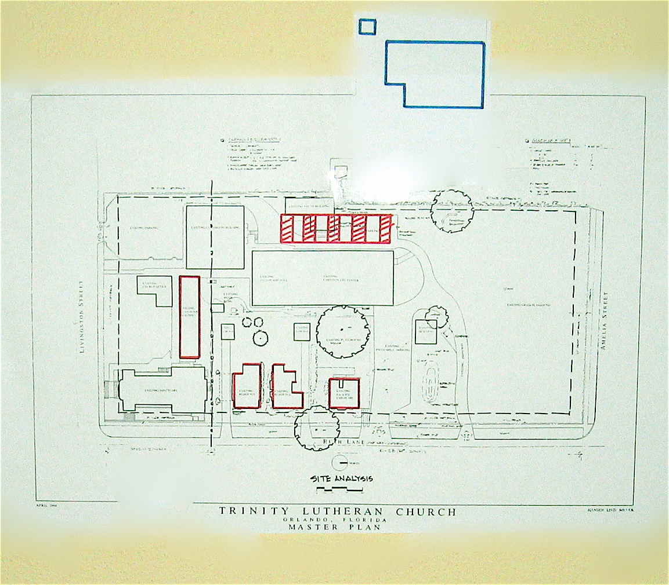
Trinity Century II:
1995 -2010 Site Changes

Slide 3

Trinity Century II:
2010 2011 2012
Depreciation Magnolia Portable Permit
Pushes Costs Use Plan Due Expires

Slide 4
Trinity Century II:
Orlando Residential Towers

Slide 5
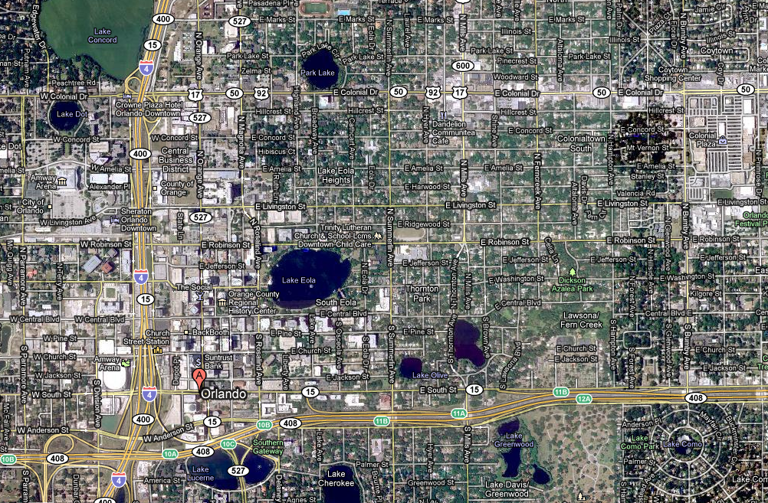
Trinity Century II:
The Residential Parks
Winter Park
Baldwin Park
College Park
TRINITY
Lake Eola
Thornton Park

Slide 6
Trinity Century II:
Commuting Corridors
Clermont Apopka Oviedo
Winter Garden Altamonte Springs
Ocoee
Windermere
MetroWest
Trinity
Hunters Creek

Slide 7
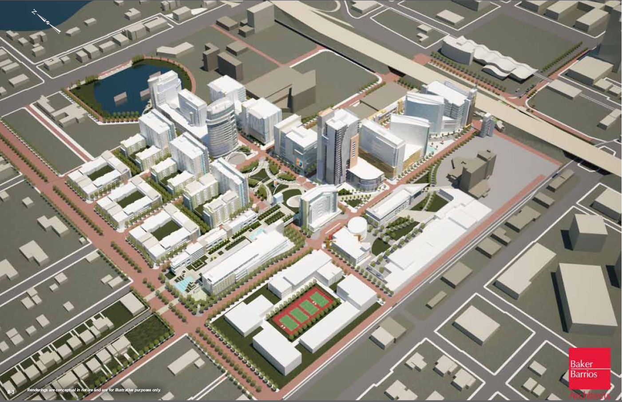
Trinity Century II:
Downtown Creative Village

Slide 8
Project Update: Sept 2011
Gov approved lite rail to 2 blocks from Trinity
City approved demolition of arena in December, 2011
Key steps towards Creative Village

Slide 9
Trinity Century II:
Trinity Mission
Proclaim the Gospel of Jesus Christ through ministries which strengthen and equip people for Christian witness and service in downtown, Metropolitan Orlando and the world.

Slide 10
Trinity Century II:
Campus Strategic Roles
Equip people to live authentic Christian lives
Provide a support hub for worldwide Missions
Connect urban souls to the main church body
Act as a neighborhood beacon to share the glory of God
Strategically regenerate itself with multiple funding sources

Slide 11
Trinity Century II:
Principal Stakeholders
Members
Parents
Neighbors

Slide 12
Trinity Century II:
3 Ministry Tracks
Feed the faithful families
Reconnect the dechurched
Introduce the unchurched

Slide 13
Trinity Century II:
Beginning The Plan
CHALLENGES
Regulatory Aging
Deadlines Buildings
7 TEAMS

Slide 14
Trinity Century II:
Campus Development Teams
Early Childhood Dev: Wren Aber (5)
Elementary School – Chuck Schultz (5)
Middle School – Bonnie Roby (5)
Worship Space – Mike Hofmann (7)
Community Youth Center – Glenda Frasier (5)
Discipleship Center – David Wilkosz (8)
Welcome/Functions – Ken Anderson (8)

Slide 15
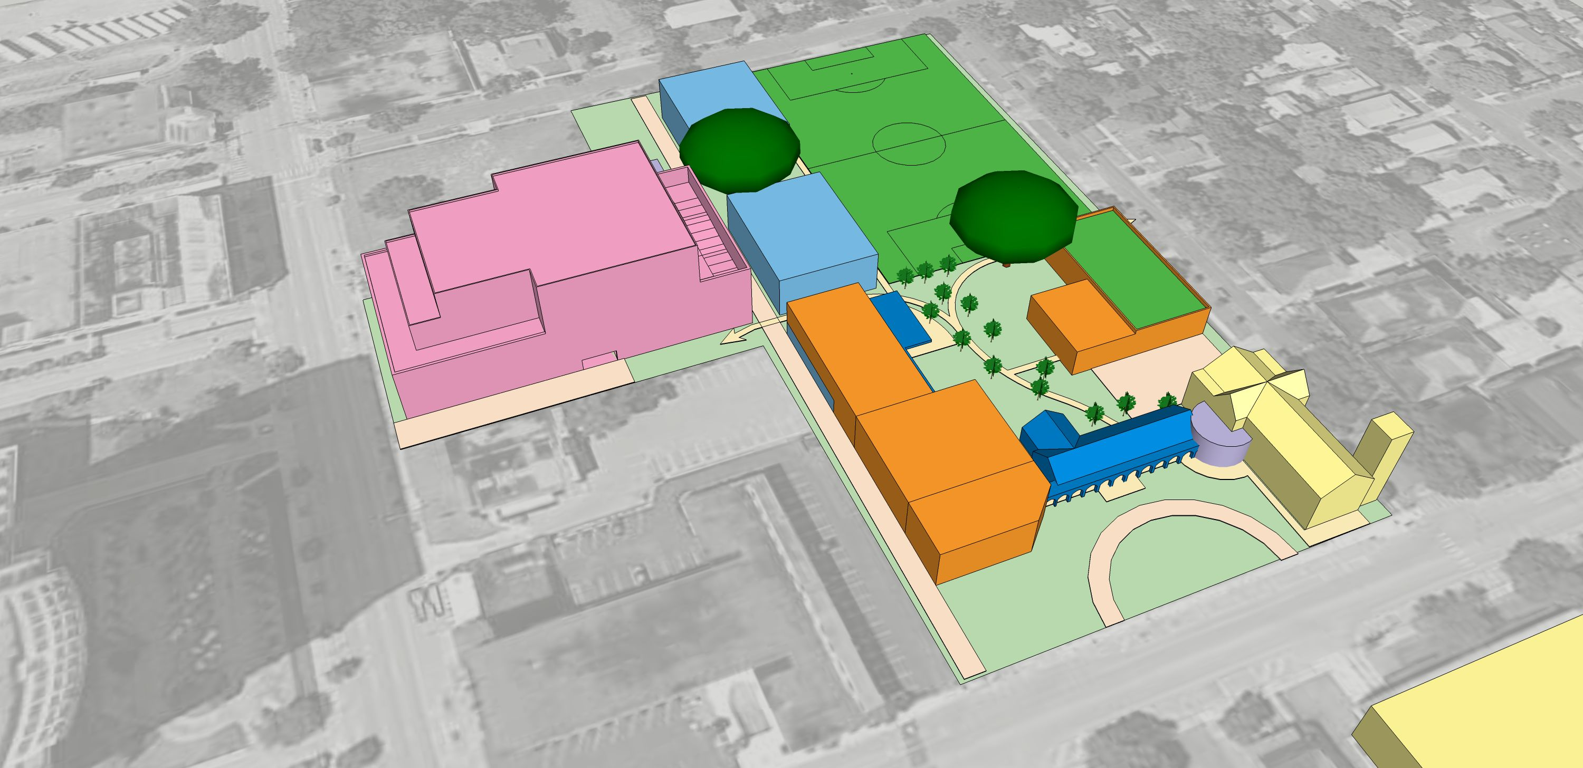
Trinity Century II:
5-Phase Master Site Plan

Slide 16
Trinity Century II:
Five Construction Phases
Phase I: Sanctuary, Green Space, Offices and CDC
Phase II: Elementary School
Phase III: Middle School
Phase IV: Trinity Center
Phase V: Auditorium & Gymnasium

Slide 17
Trinity Century II:
Construction Design Themes
Respect the environment Energy efficiency
Sustainable materials Multi-use spaces
Historical sensitivity State of the art security
Architectural interest Parks, trees, gardens

Slide 18
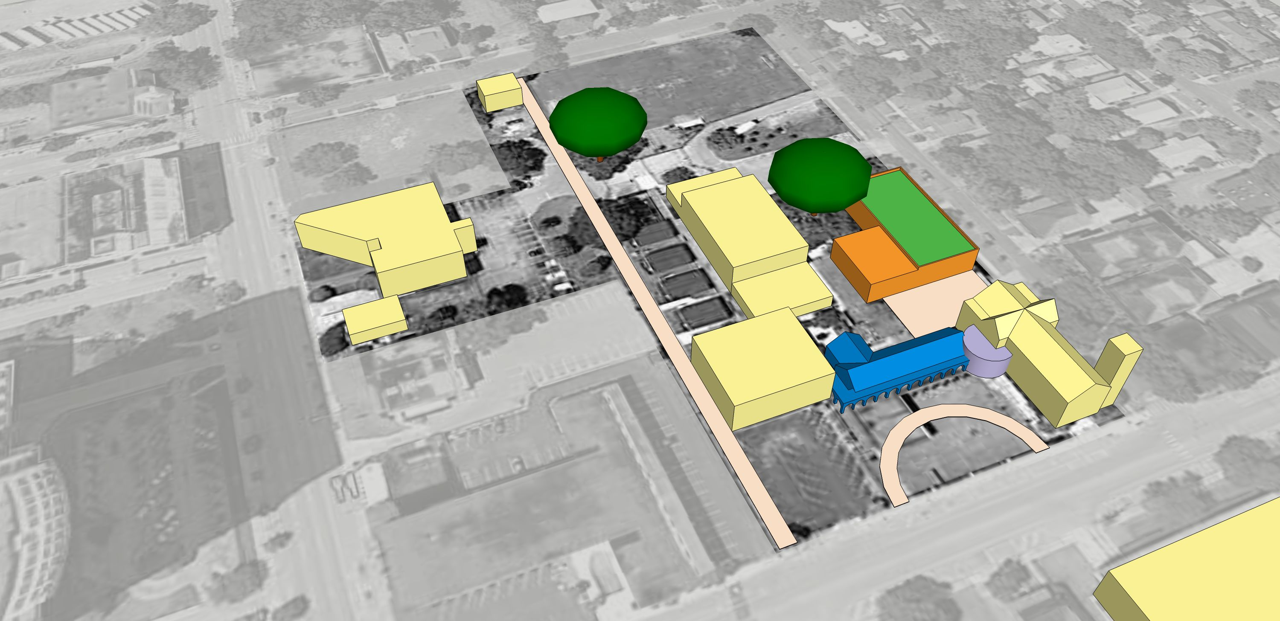
Trinity Century II:
Phase I: Spring, 2011

Slide 19
Trinity Century II:
Phase I
Strategic Mission Roles
1. Teach and proclaim the gospel
-new worshippers, new settings
-more attractive school
-modern, first class CDC
2. Beacon to share the Glory of God
-attract visitors
-make guests want to return
-welcome entry

Slide 20
Trinity Century II:
Phase I: Worship Growth Enhancements
SANCTUARY
  Refurbish (carpet, cushions, lighting,
energy use, new bathrooms)
  Convert Undercroft to usable space
  Purchase new organ console
  Re-landscape exterior

Slide 21
Trinity Century II:
Phase I: Worship Growth Enhancements
GYMNASIUM
  Upgrade seating, carpet runners, lighting,
sound baffles and controls
FELLOWSHIP/DINING
  Redecorate (walls, floor, ceiling, seating, electronics)

Slide 22
Trinity Century II:
Phase I: Open Campus Green
  Remove fence, lower lawn
  Add circular driveway entry
  Open arches for walkway thru Logia
  Welcome Center – Logia to Sanctuary
  State of the Art Security

Slide 23
Project Update: Sept 2011
New organ console due in Nov
Undercroft delayed til MAY (Cash Flow)
Relandscape after CDC Bldg Complete
Gym worship setting begins Nov 7,2011
Fellowship Hall half completed – vol labor

Slide 24
Trinity Century II:
Phase I: Consolidated Offices
  Open office system for efficiency
  Private rooms for counseling
  Common work space for efficiency
  Expanded left end for school staff
  School offices near existing parking and classrooms
  All new landscaping

Slide 25
Trinity Century II:
Phase I: Build New CDC
  Replace the 3 cottages with an
efficient new CDC building
  Replace the temporary classrooms
  Centralize all under one roof
  Single security zone – classrooms + playgrounds

Slide 26
Trinity Century II:
Phase I: Build New CDC
    Architectural companion
to historical district
    36 infants (3 rooms X 4 – 3 rooms X 8 )
    14 classrooms X 20 students (capacity)
    5 staff/parent rooms
    Covered, secure drop off
    3 playgrounds and gardens

Slide 27
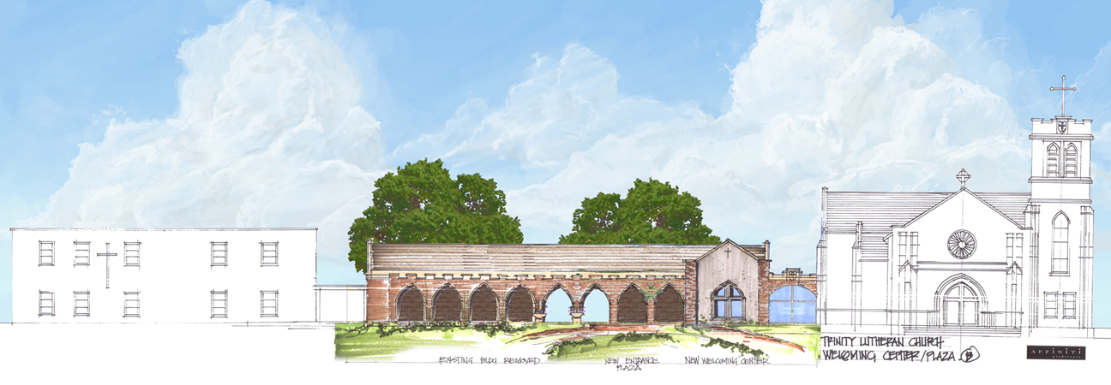
Trinity Century II:
Loggia Office Suite & Livingston Green

Slide 28
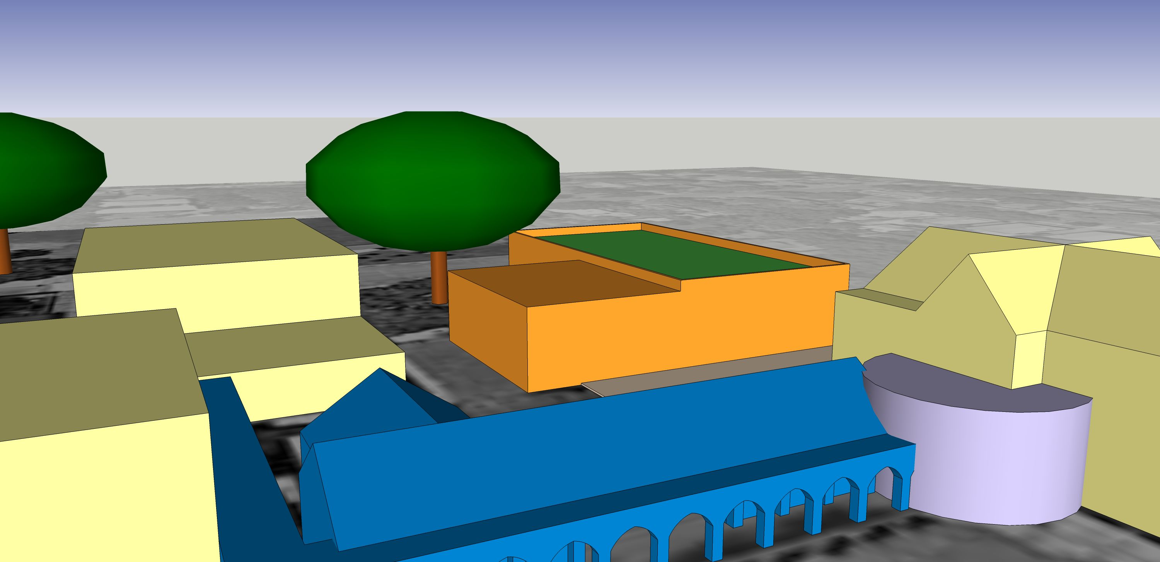
Trinity Century II:
Phase I: Build New CDC

Slide 29
Trinity Century II:
Phase I: Community Ministry and Youth Center
  2d Floor is virtually “free”
  Flex space: Youth Group, clubs, meetings,
  Community Ministry (mentoring)
  Sunday School/Bible classes
  Canteen, office support room
  AV, tables and chairs all rooms
  Conference rooms (1 large/2 small)
  Storage

Slide 30
Trinity Century II:
Phase I: Rooftop Wedding Garden
  Portable planters with small trees, evergreens
  Water retention, storage
  Elevator (all 3 levels)
  Portable sound, lighting
  Decorative fountain features
  Floral display planters

Slide 31
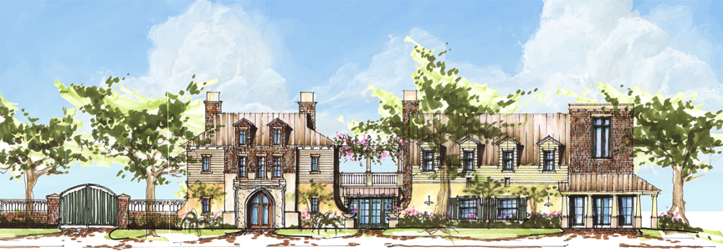
Trinity Century II:
Phase I: Architectural Hi-Lites

Slide 32
Project Update: Sept 2011
Key is hist homes/community relations
Presented plan with elevation sketch – neighbors urged us to restore/incorporate the 3 homes
We conducted workshop with 2 options:
  New building /half old homes adjoined
  New building with old homes replicated as façade--rejected

Slide 33
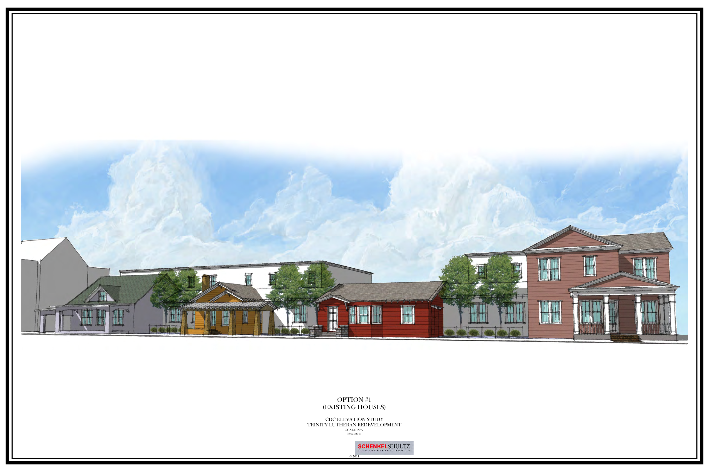
Project Update: Sept 2011

Slide 34
Project Update: Sept 2011
Final Solution: combination moving/conserving 3 houses + new building
Other changes:
-move wedding garden to ground (expense)
-enlarge classrooms (new state standard)
-delay demo school office, update existing loggia office suite (add expansion later) (expense)
-complete front, side landscaping (open up view)

Slide 35
Trinity Century II:
Phases Il and lll: Spring, 2013
    Phase II: Elementary School
    Phase III: Middle School

Slide 36
Trinity Century II:
Phases Il and lll
  Strategic Mission Roles
    Teach and Proclaim The Gospel
  -age-appropriate curricula
  -consistent Christian message
  -foundation for high school
    Prepare For Christian Lives
      -provide context for modern life
  -new families on campus daily
  -fellowship growth track

Slide 37
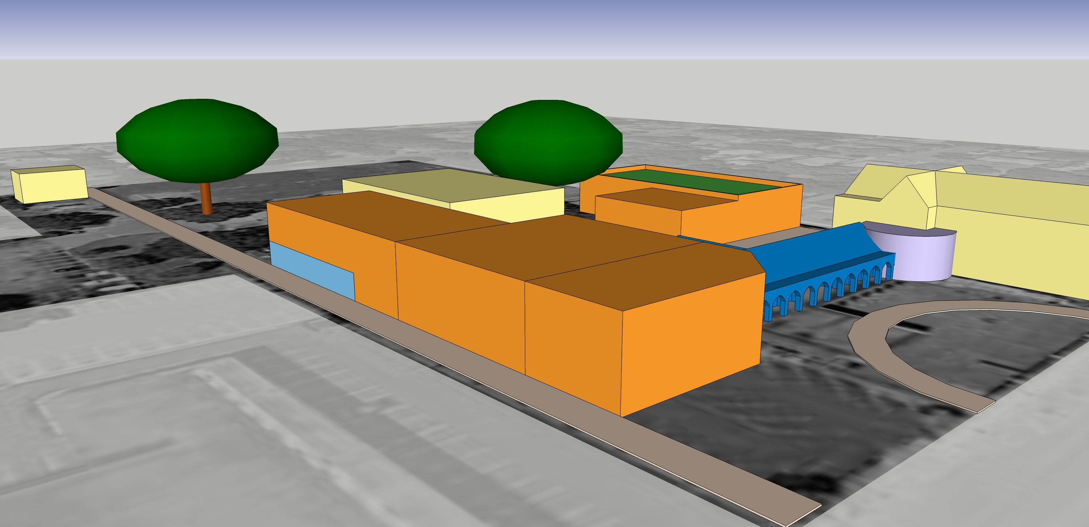
Trinity Century II:
Phases Il and lll: School Buildings

Slide 38
Trinity Century II:
Phases Il and lll: Key Features-Elementary
    12 classrooms (2 per grade)
    media center, music
    6 enrichment “club” rooms
    new bathrooms
    roof-top gardens
    fire suppression safety system
    covered walkways/drop off
    expanded sports facilities

Slide 39
Trinity Century II:
Phases Il and lll: Key Features-Middle School
    6 classrooms (2 per grade)
    arts center
    media center (live broadcasts)
    fire suppression system
    official sized soccer field
    new lockers, sports equipment
    roof-top gardens, playground
    2 enrichment “club” rooms

Slide 40
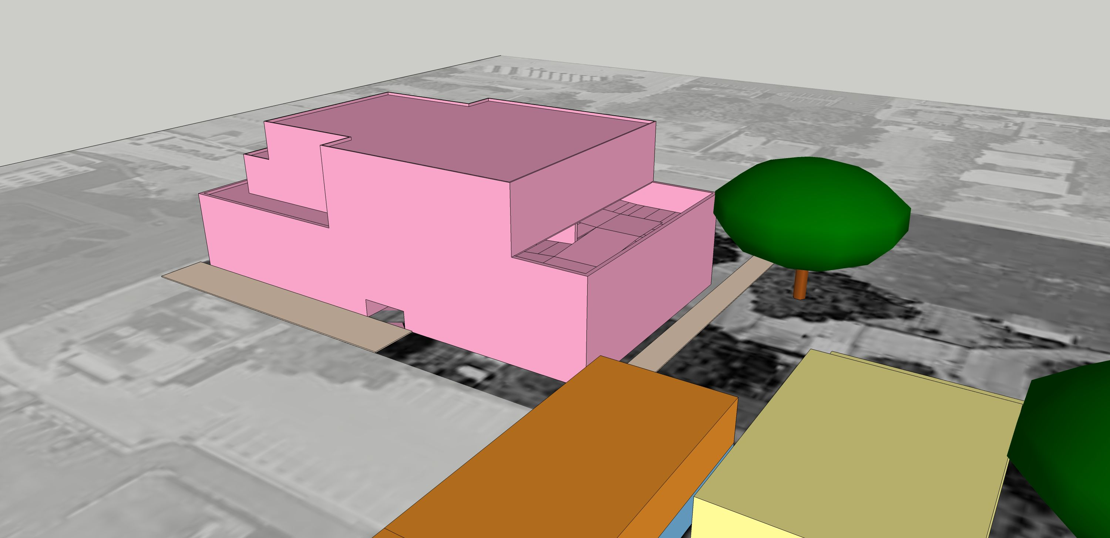
Trinity Century II:
Phase IV: Trinity Center

Slide 41
Trinity Century II:
Phase IV: Trinity Center
STRATEGIC MISSION ROLES
    1. Support hub for Fellowship growth
2. Equip people to live Christian life
      3. Support worldwide missions
4. Connect urban souls to main Church body
5. Beacon to share glory of God
6. Regenerate campus with multiple funding sources
7. Center for substantial senior population

Slide 42
Trinity Century II:
Phase IV: Trinity Center Features
    Destination restaurant “Luther’s Monastery”
    “Courthouse Coffee Shop”
    Private Radio Station
    Upscale Office Suites
    Assisted Living Facilities (3 Tiers)
    Discipleship/Missions Space
    Entertainment Arts Center

Slide 43
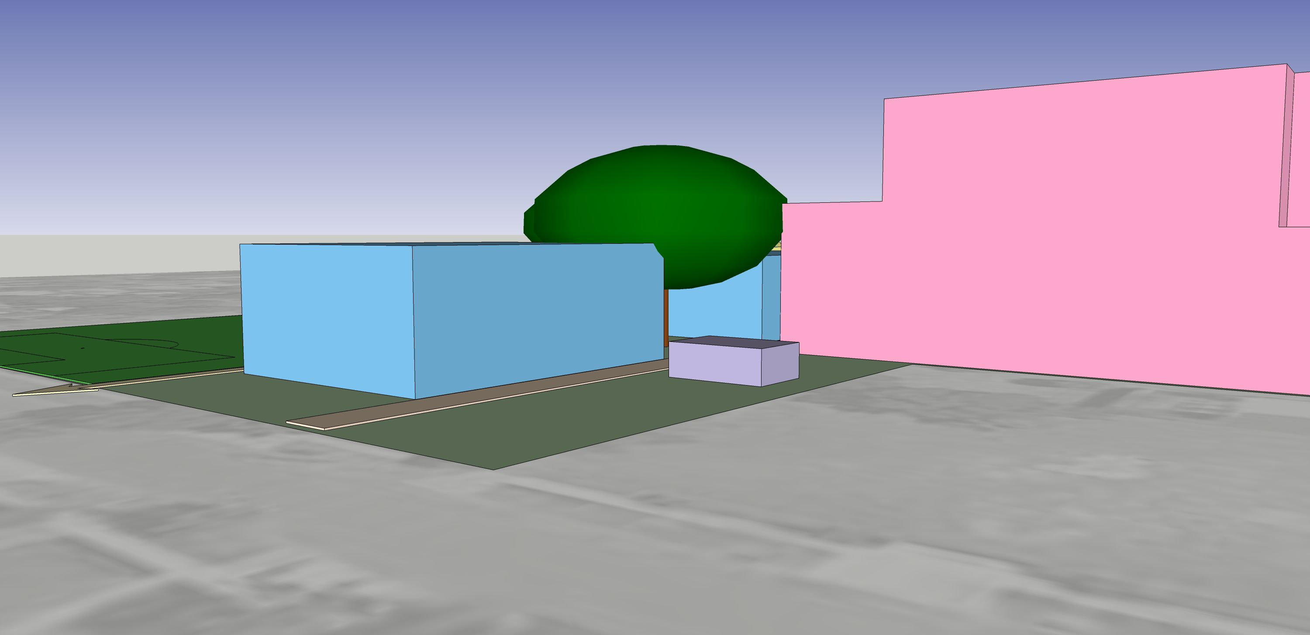
Trinity Century II:
Phase V: Arts and Sports Complex

Slide 44
Trinity Century II:
Matching The Campus To The Mission
FINANCIAL STRATEGY
    Unselfish labor has maintained facilities
    Staff has sacrificed in good faith
    Low school enrollment drains church funds
    Getting to 200 students will restore momentum
    This plan rebuilds school enrollment
    from the CDC

Slide 45
Trinity Century II:
Matching The Campus To The Mission
FINANCIAL STRATEGY
    better facilities will attract older students
    must use NON-OPERATIONS funds to avoid risk to staff
    restoring the school frees up funds for
    other missions, including seniors
    completed campus will generate growth
    and fuel future missionary work

Slide 46
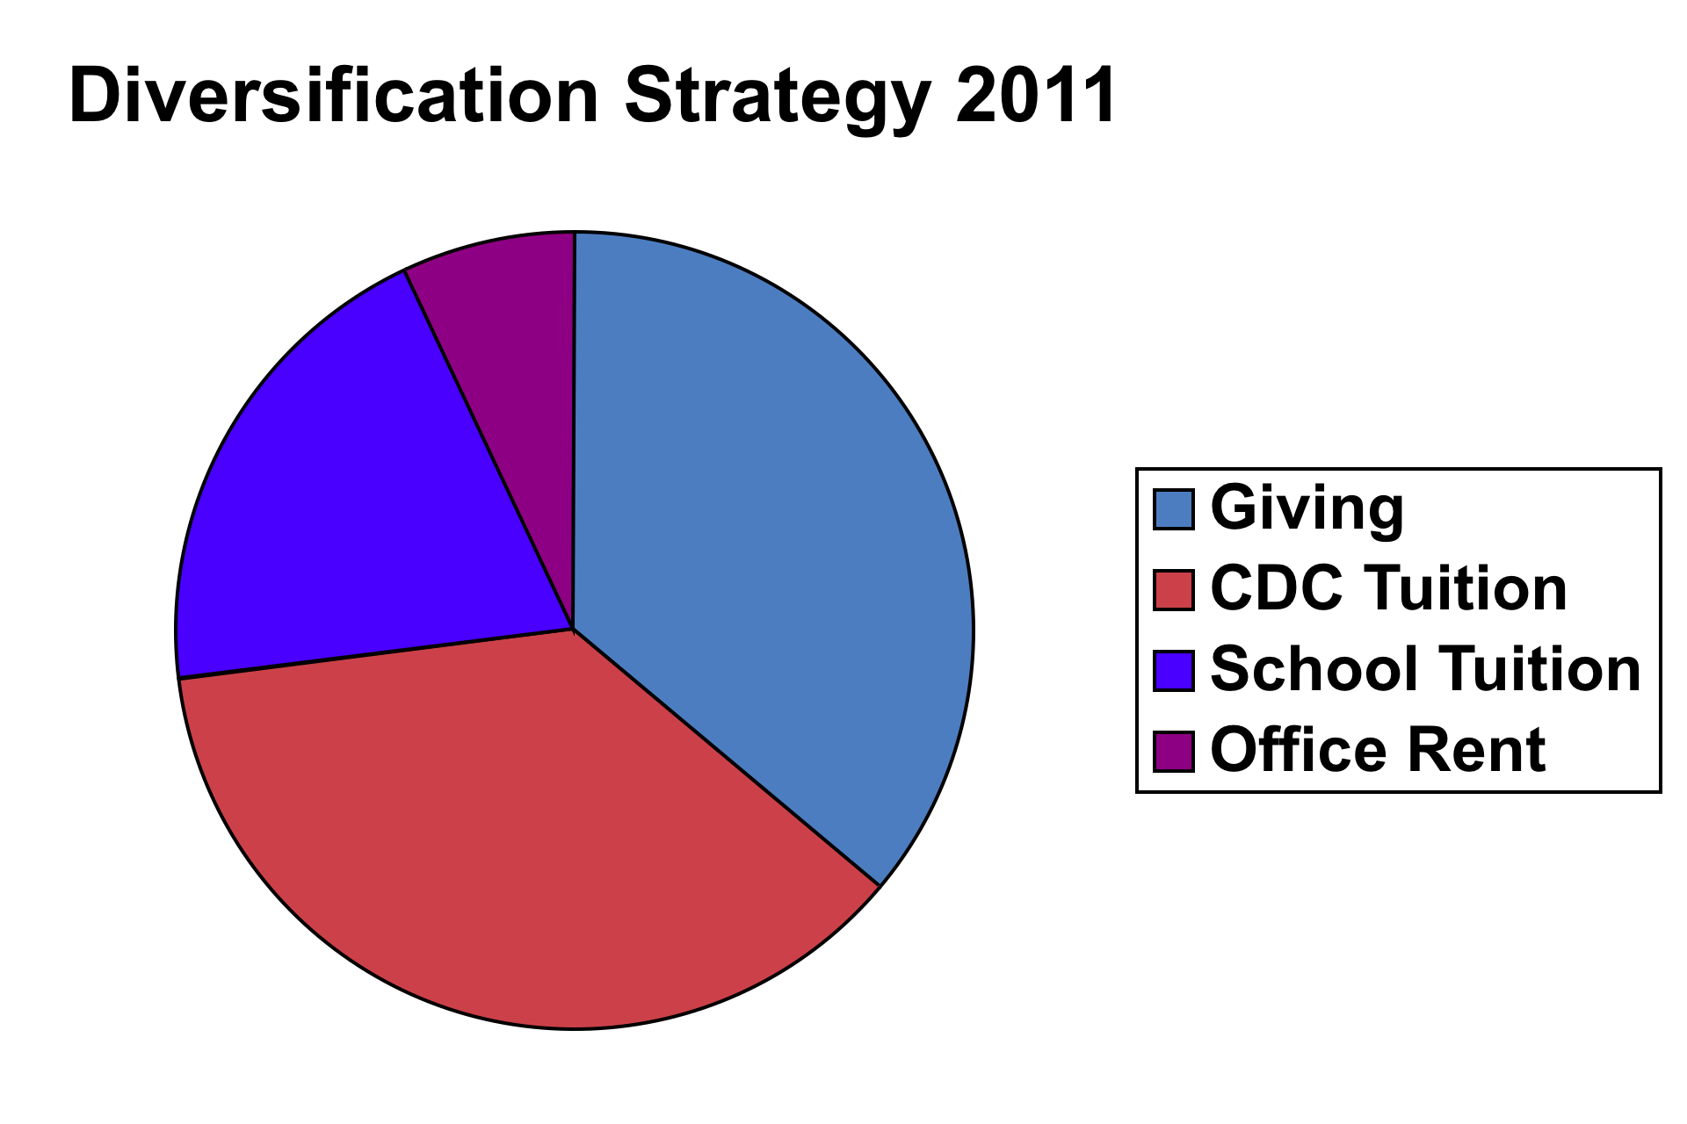
Trinity Century II:
Matching The Campus To The Mission

Slide 47
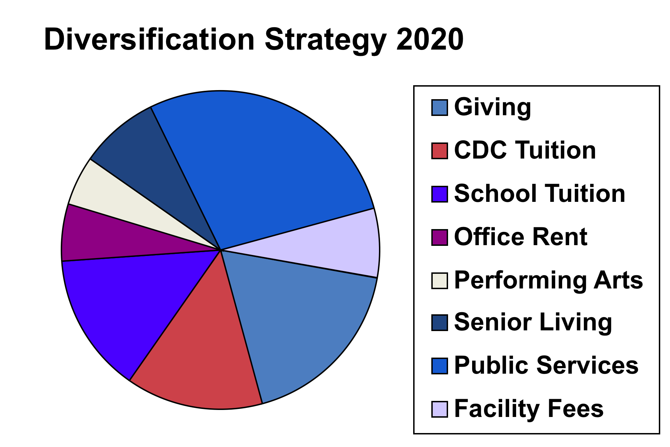
Trinity Century II:
Matching The Campus To The Mission

Slide 48
Trinity Century II:
OPERATING
FUNDS
CAPITAL
FUNDS

Slide 49
Trinity Century II:
Mortgage/Income Template
  2 yr construction intervals
  “Traditional” income sources
  Mortgage: 5% over 20 years
  Mortgage secured by property

Slide 50
Trinity Century II:
PHASE #1: Worship, CDC, Offices, Community/Youth Centers
Pre-Construction Funding Sources
Cash (Dedicated Funds) $361K
Cash (Sanctuary Dedicated Funds) 110K
Capital Fund Drive 80K
TOTAL CASH ON HAND $551K
MORTGAGE ADDITION $4,400K
Funds Available for Phase #1 $4,951K

Slide 51
Trinity Century II:
PHASE #5: Arts and Sports Complex
Pre-Construction Funding Sources
Additional CDC Tuition $180K
Additional Extend Care 150K
Elementary School 600K
Middle School 360K
New Church Giving 1,000K
Wedding Receptions 375K
Cash (Dedicated Funds) 10K
Urban Mission Centers (5) 50K
Apartment Rent 576K
…PLUS

Slide 52
Trinity Century II:
PHASE #5: Arts and Sports Complex
  Pre-Construction Funding Sources (contd)
  Office Rent $640K
  Arts Center/Radio Rent 380K
  Restaurant Lease 800K
  Coffee Shop Lease 600K
  Parking Garage Rent 800K
  Contingency/Bal Forward 131K
  New Mortgage Expense 00K
  TOTAL FUNDS AVAIL PHASE V $8,172K

Slide 53
Trinity Century II:
Operations and Missions
2012 -2022
2022 -2032
* Reflects Progress Payments

Slide 54
Trinity Century II:
Matching The Campus To The Mission

Slide 55
Trinity Century II:
Matching The Campus To The Mission
1. Adopt Master Plan
2. Start Phase I

Slide 56
Project Update: Sept 2011
Select Arch/Construction Firm (Sept)
Neighborhood Buy-in/Historical Bd Approval
Mortgage/Capital Dr (Nov)
Master Site Plan
Begin Construction Phase I

